Slide 1

How do Organisms
Reproduce?
Sexual Reproduction in flowering plants (Double fertilization, formation of fruit, germination)

Slide 2
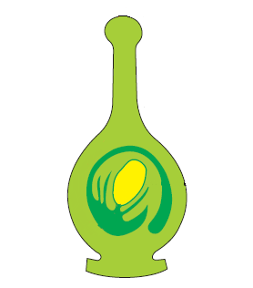
Sexual Reproduction in flowering plants
After the pollen lands on a suitable stigma, it has to reach the female germ-cells which are in the ovary.
Two male gametes appear at this point in the pollen tube.
The pollen tube grows through the stigma and style by dissolving the tissues and reaches the ovary
Of these, one sperm nucleus enters the egg cell and fuses with its nucleus,
All together there have occurred two fertilizations.
Thus it is called as DOUBLE FERTILISATION.
For this, a tube grows out of the
while the other sperm nucleus moves towards the two
One sperm nucleus fused with egg cell nucleus.
The other sperm nucleus fuses with two polar nuclei together.
pollen grain and travels through the style to reach the ovary.
polar nuclei in the central cell and fuses with them.
Thus 3 nuclei together to produce the endosperm nucleus
Pollen tube
Male gamete nuclei
Endosperm

Slide 3
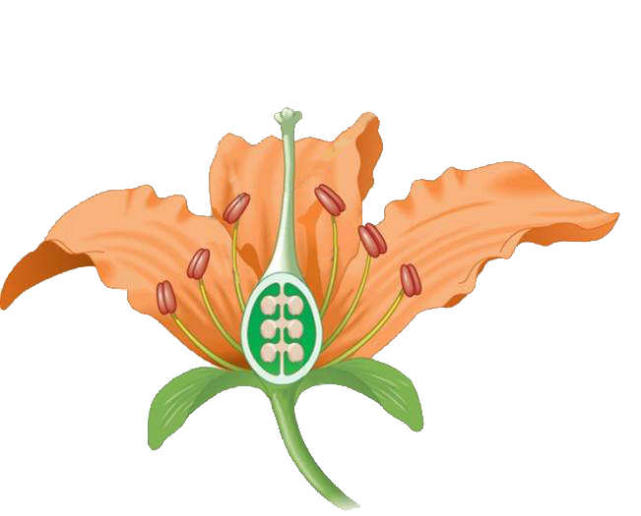
Sexual Reproduction in flowering plants
After fertilization, the flower has served its purpose.
The petals, stamens, style and stigma wither and generally fall off.
Become Dry
Stigma
Style
Petals
Stamens
Sepals

Slide 4
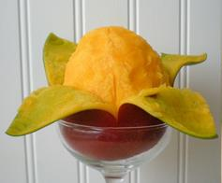

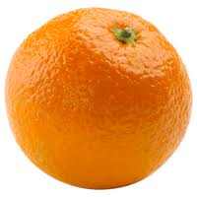
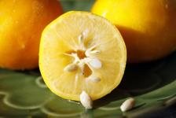
Sexual Reproduction in flowering plants
The ovary enlarges to form fruit,
the ovarian wall forming the fruit wall.
Ovules become the seeds.
Fruit wall
Ovules
Ovary
Ovarian wall

Slide 5
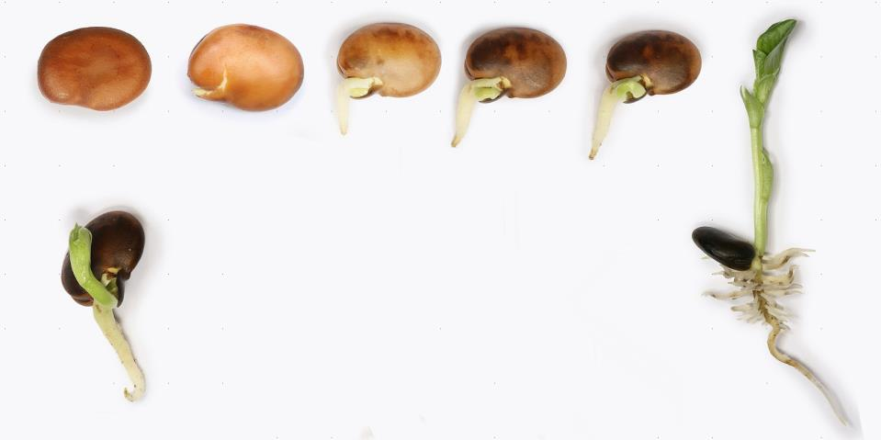
Sexual Reproduction in flowering plants
The seed contains the future plant or embryo.
Embryo

Slide 6
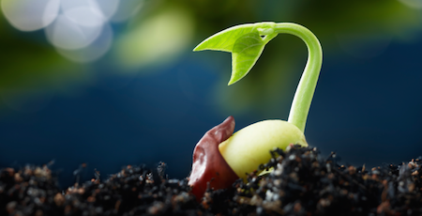
Sexual Reproduction in flowering plants
Embryo develops into a seedling under appropriate conditions.
This process is known as germination.

Slide 7
Thank You

